Slide 1
RNA Secondary Structure
Prediction
● Using Context Free Grammars ●
Ali Ahmadi Esfidi

Slide 2
01
Abstract
02
Context Free Grammar
CONTENTS
03
Column Probablity
04
Grammar Algorithms
05
Implementation

Slide 3
01
Abstract

Slide 4
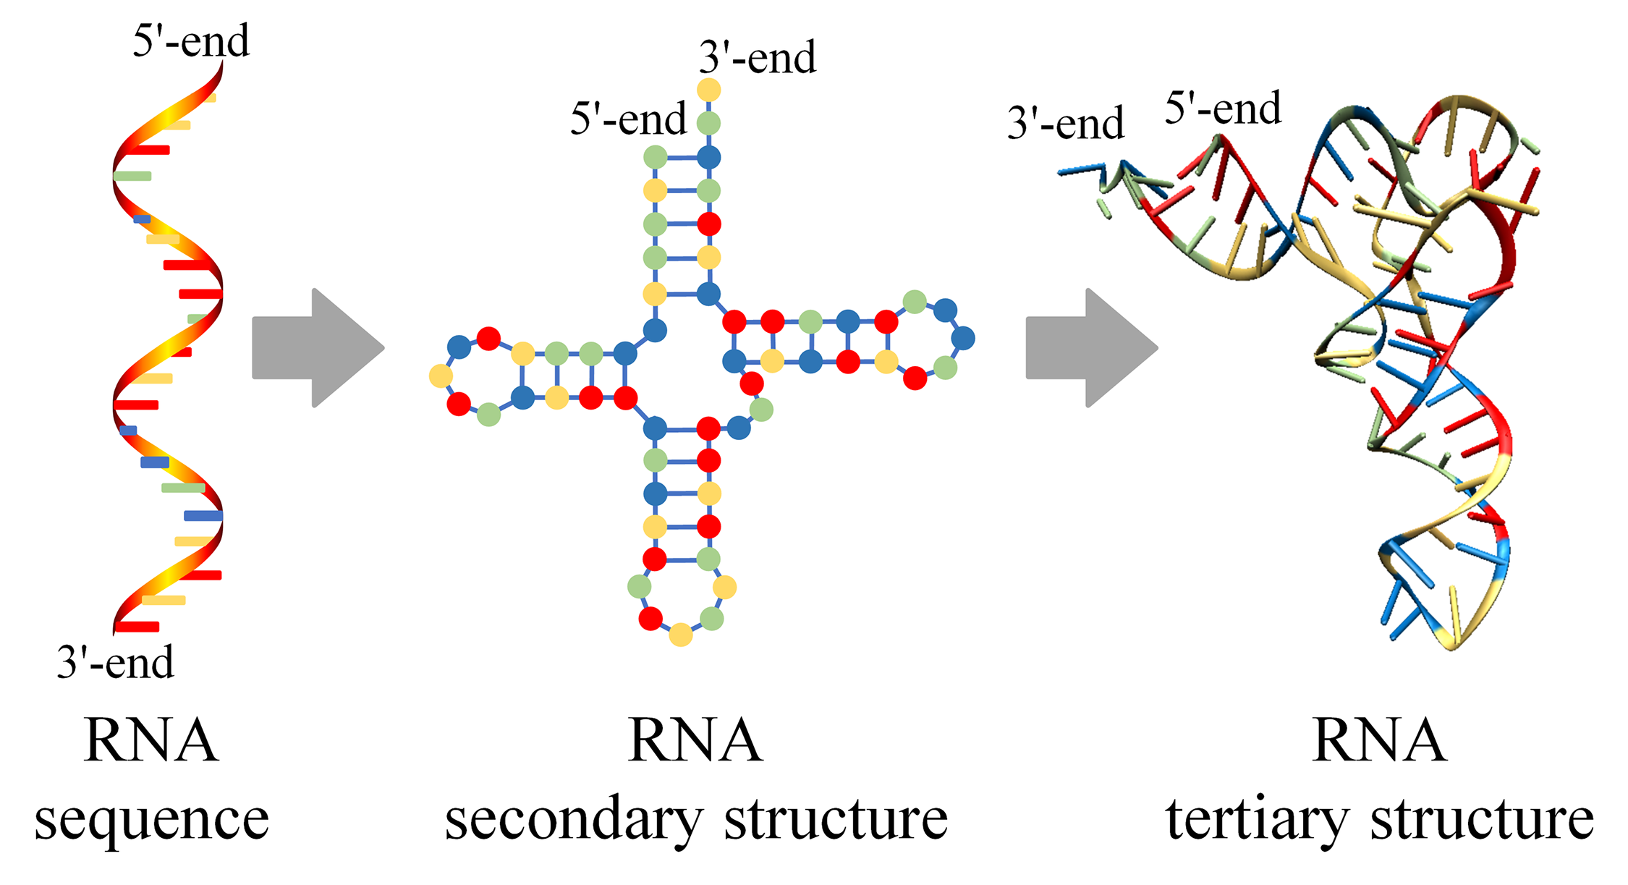
RNA Secondary Structure

Slide 5
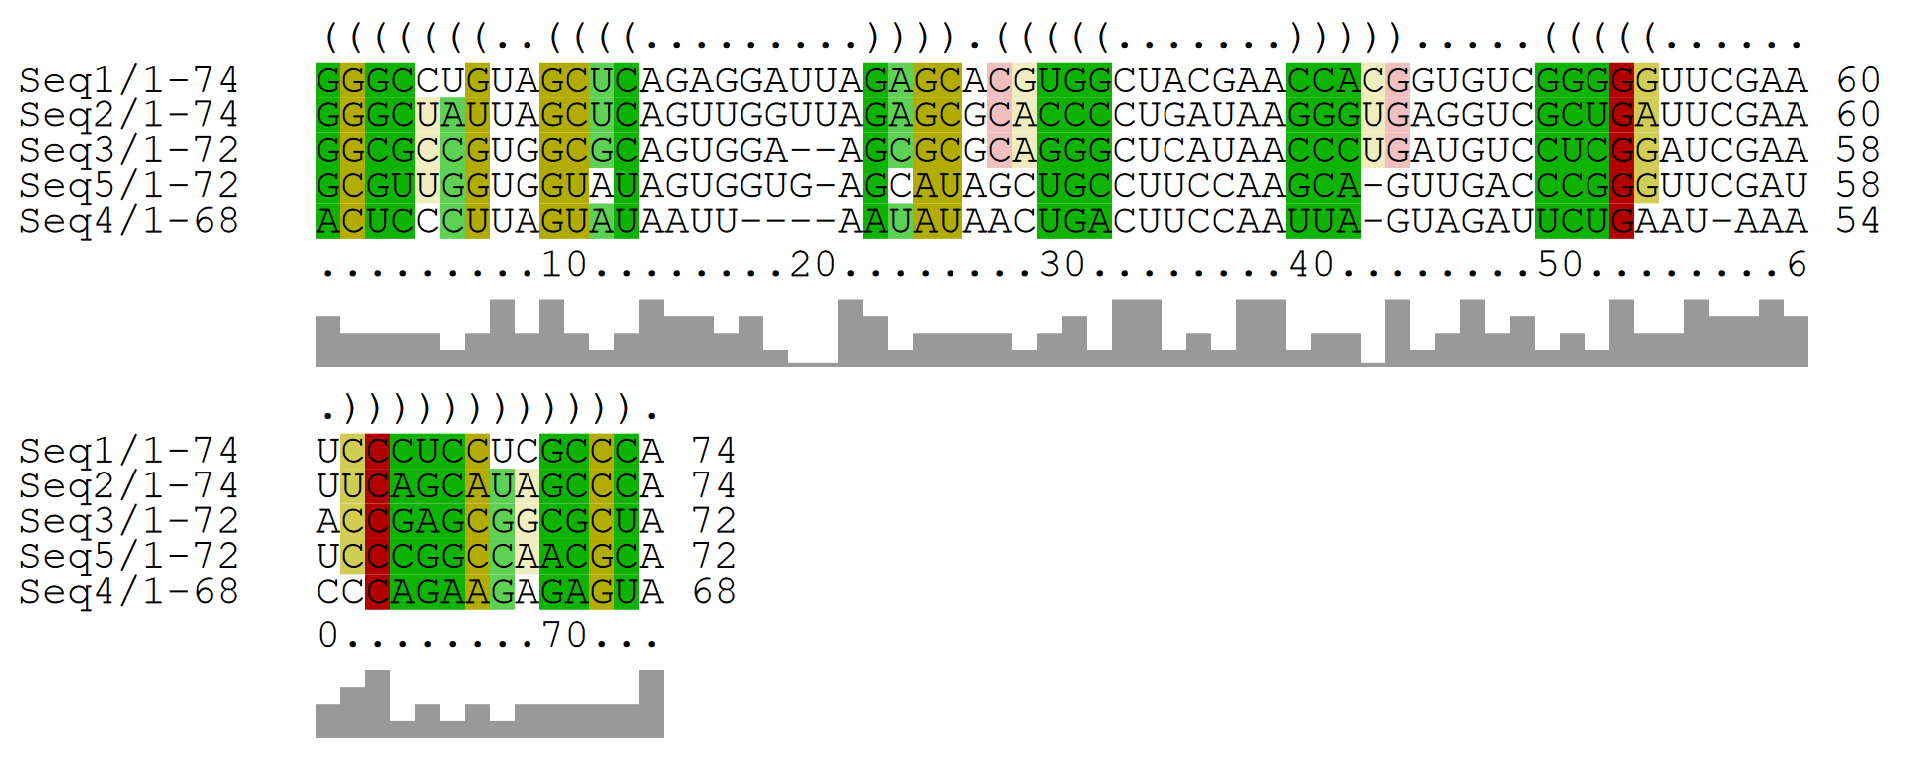
Input And Output
Using Stochastic Context Free Grammar !!

Slide 6
02
Stochastic Context Free Grammar

Slide 7
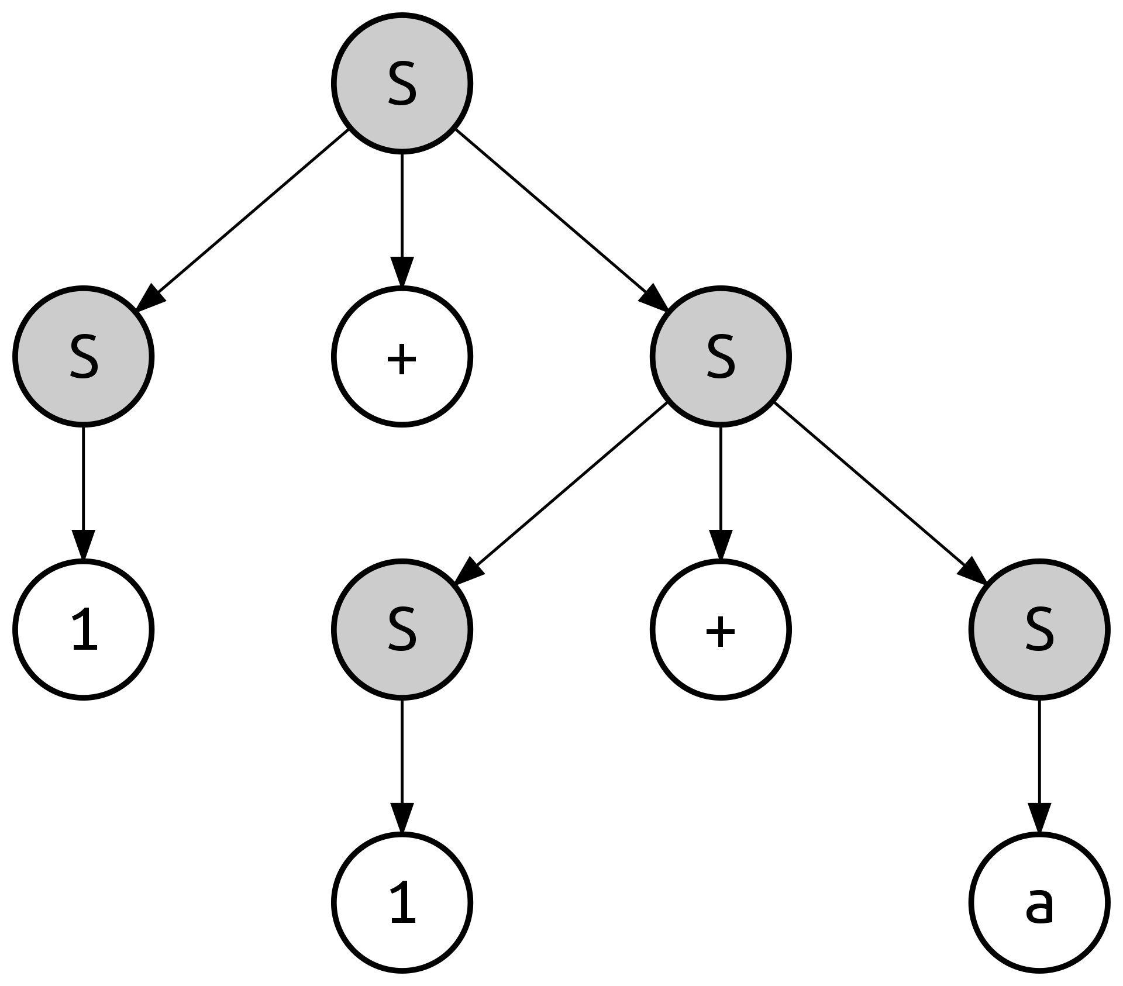


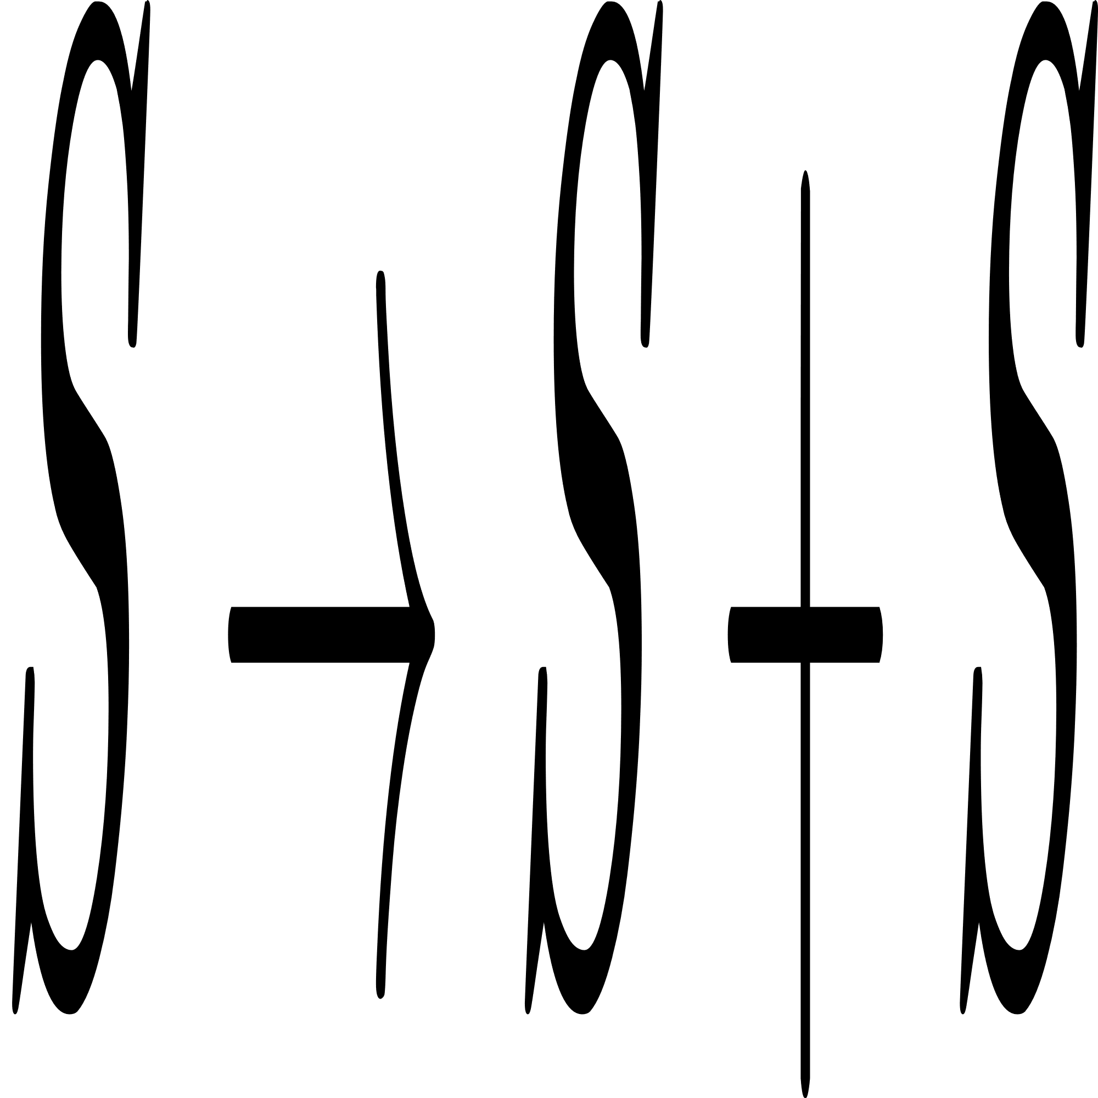
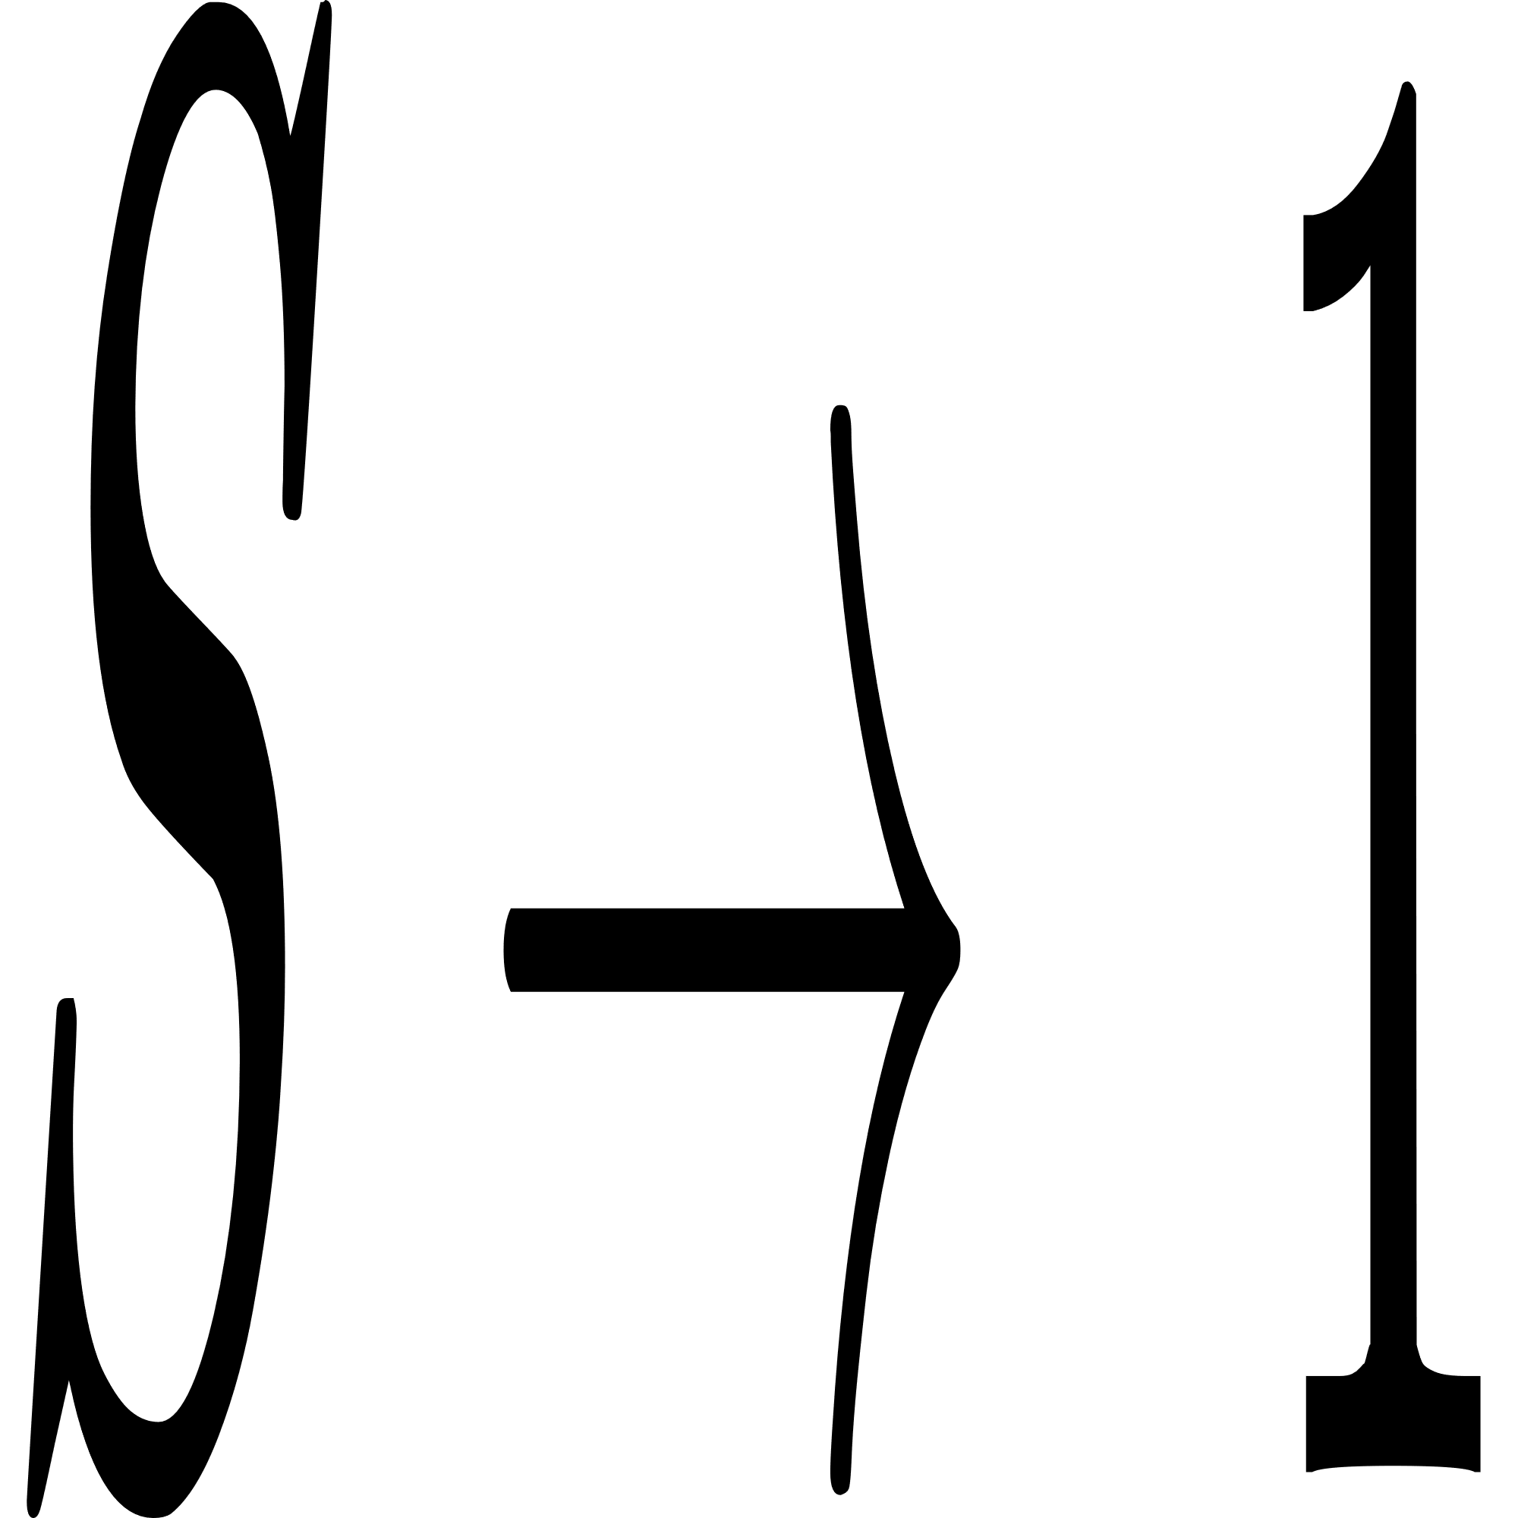
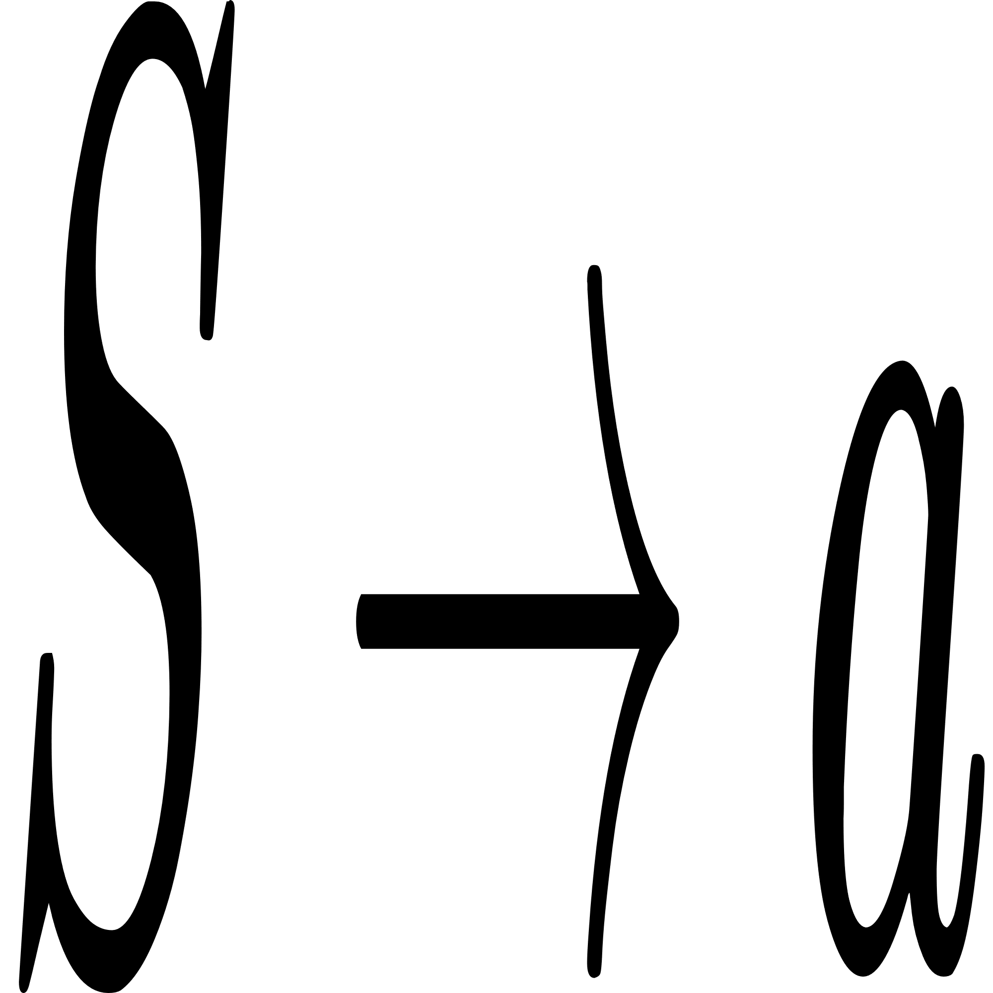
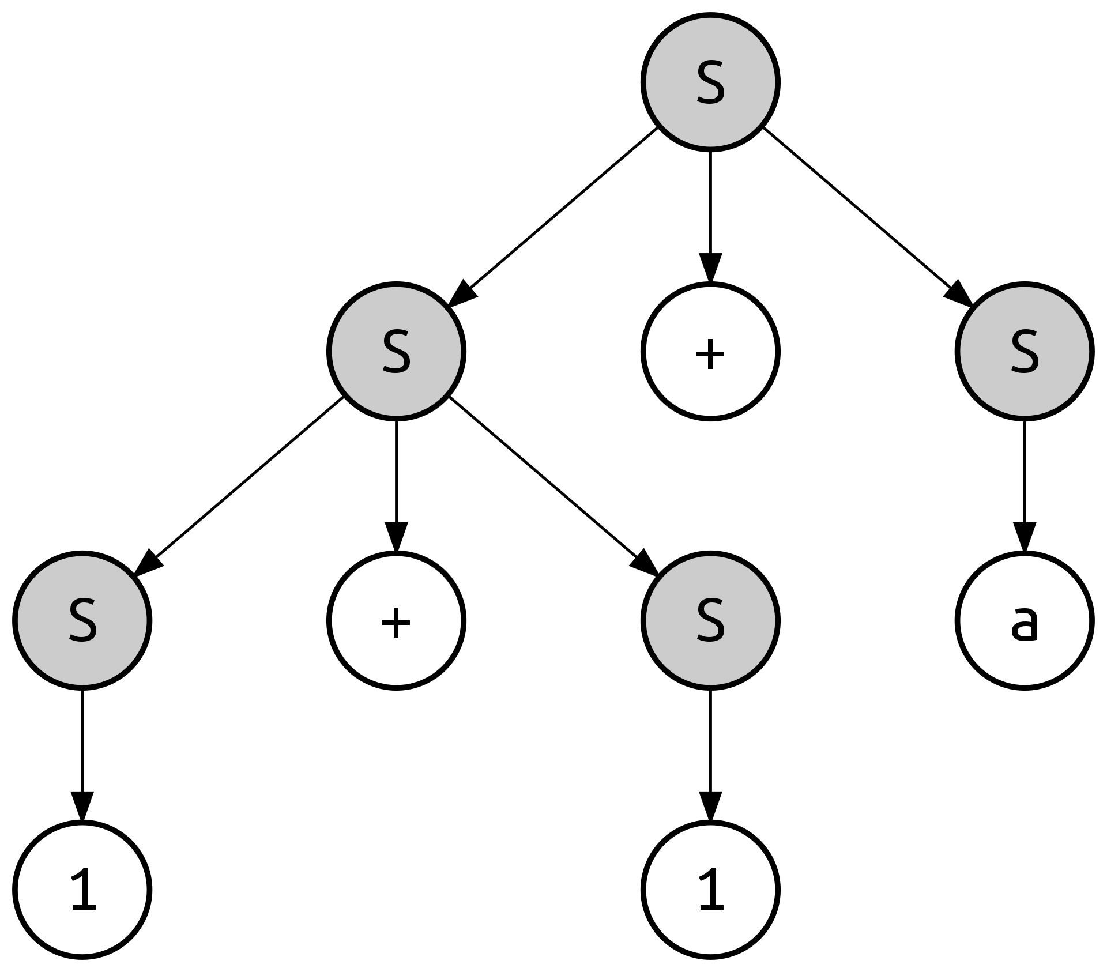

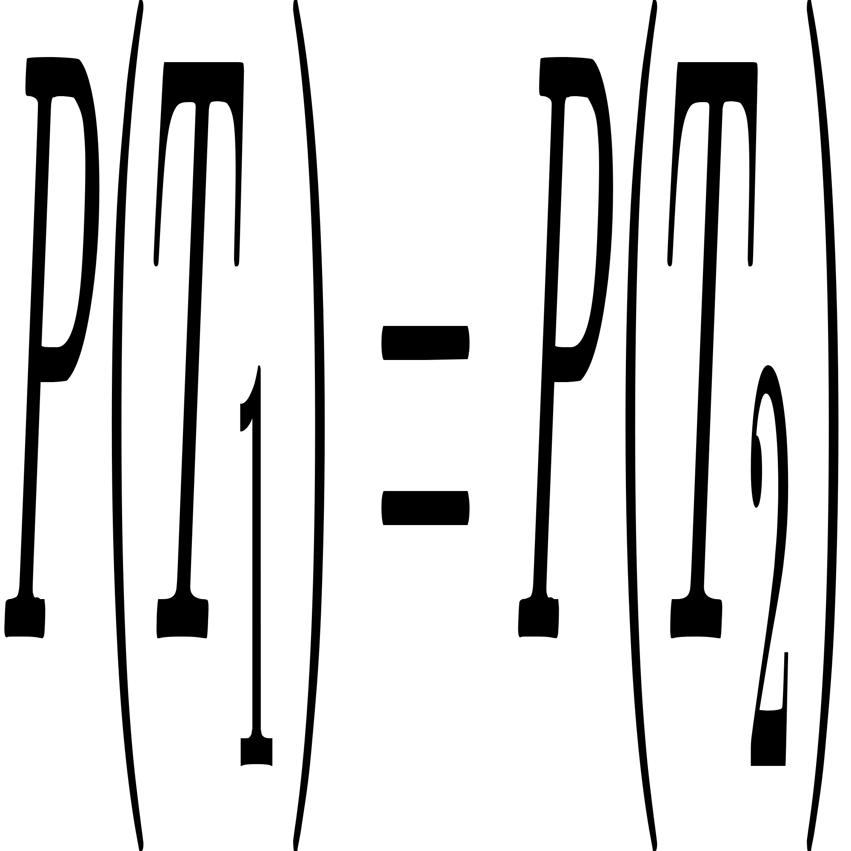
Stochastic Context Free Grammar
+ P
60%
30%
10%
= 0.6 * 0.6 * 0.3 * 0.3 * 0.1
Not Always true in PCFG :)

Slide 8
Back To Problem
A
A
A
A
A
A
A
A
A
C
A
A
A
A
G
A
A
A
A
U
A
A
A
C
A
What are terminals?!
...
So, we need to calculate all possible columns probablity, in two state of being single base or pair base.

Slide 9
03
Column Probablity

Slide 10
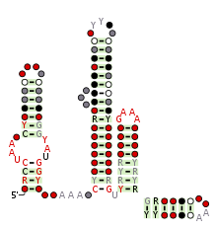

Primary Data Used
Family name : LOOT (RF03000)
Number of taxa : 368
Number of sites : 203

Slide 11
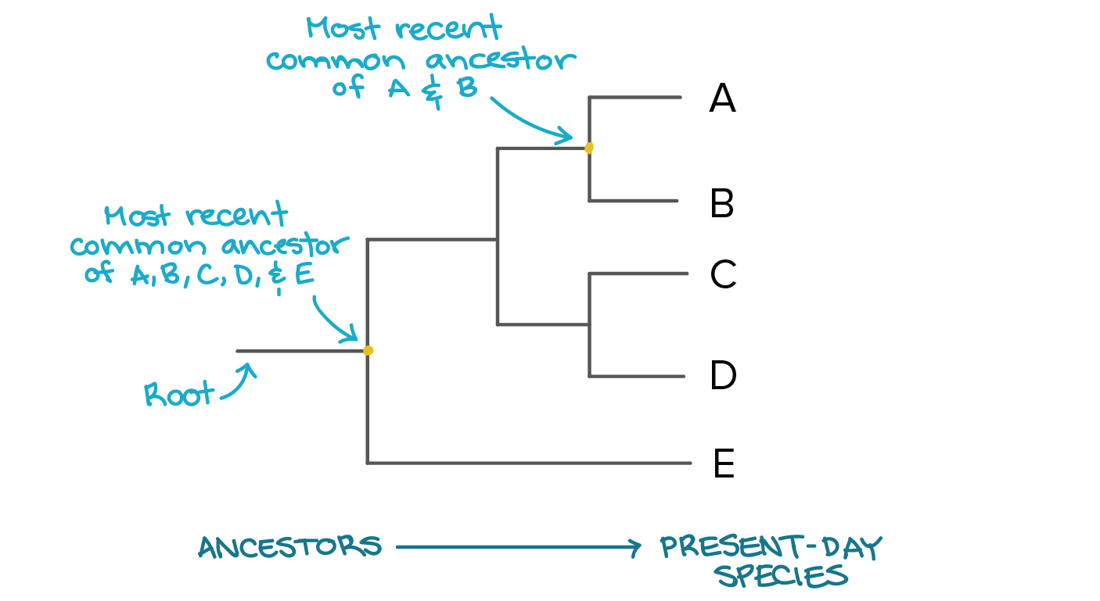
Phylogenetic Tree

Slide 12
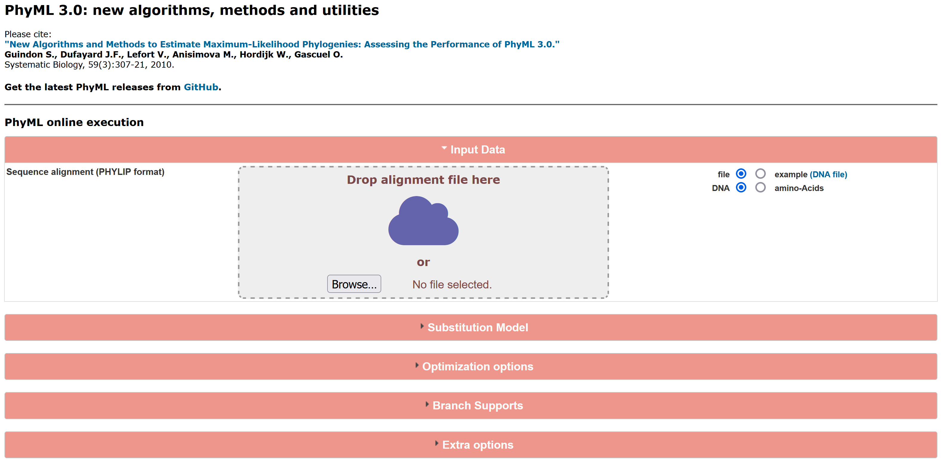
PhyML

Slide 13
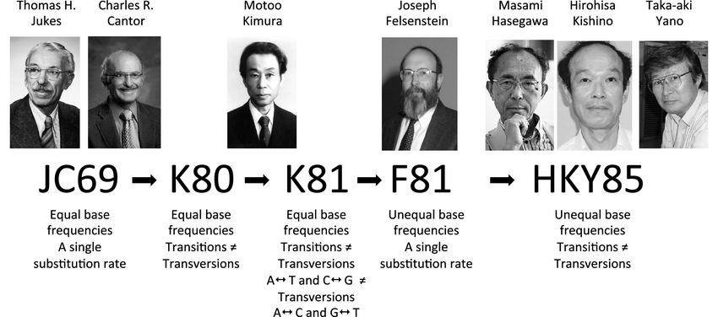
Substitution Models

Slide 14
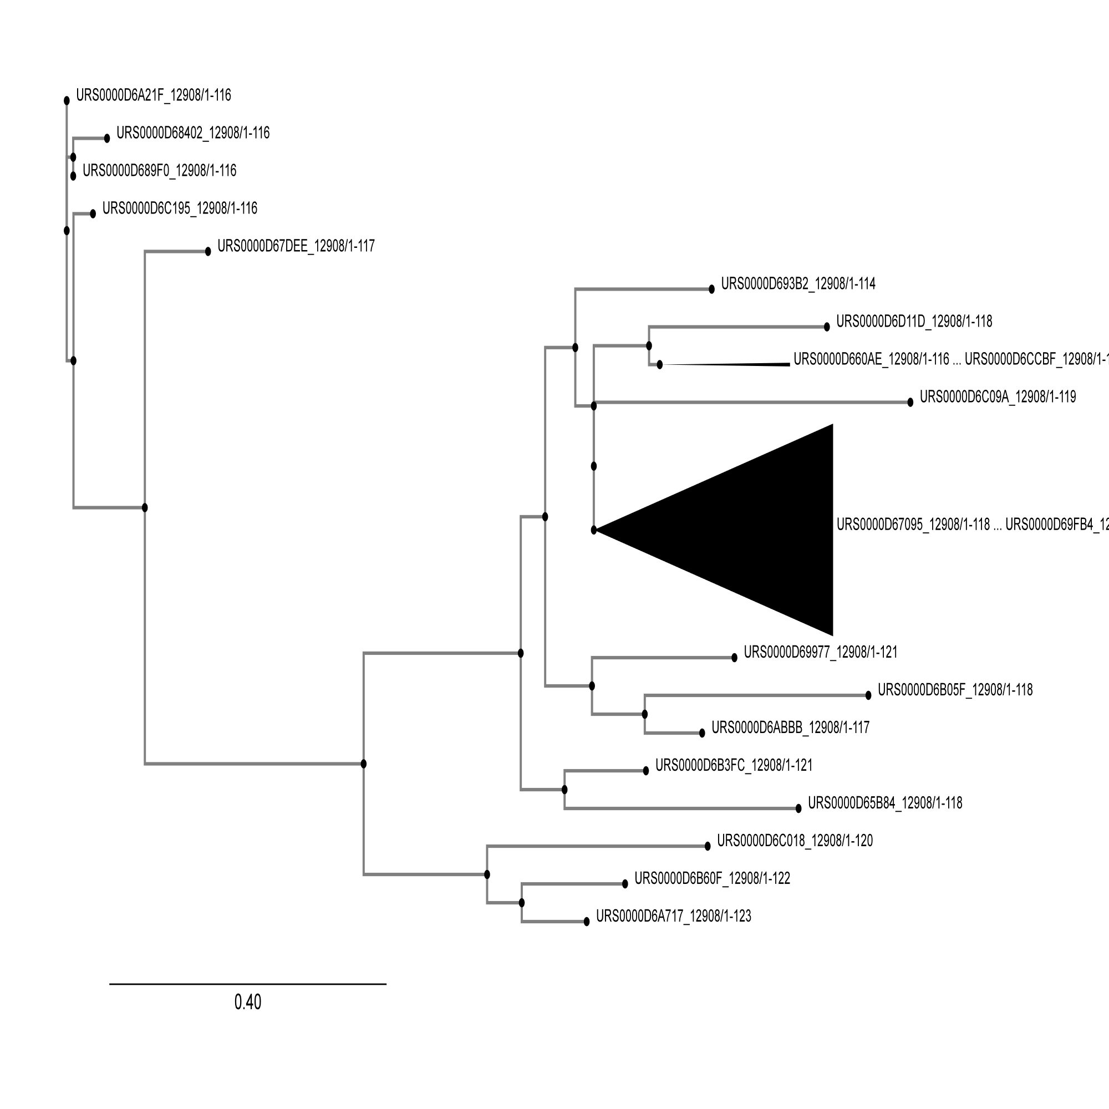
Tree Of Primary Data

Slide 15
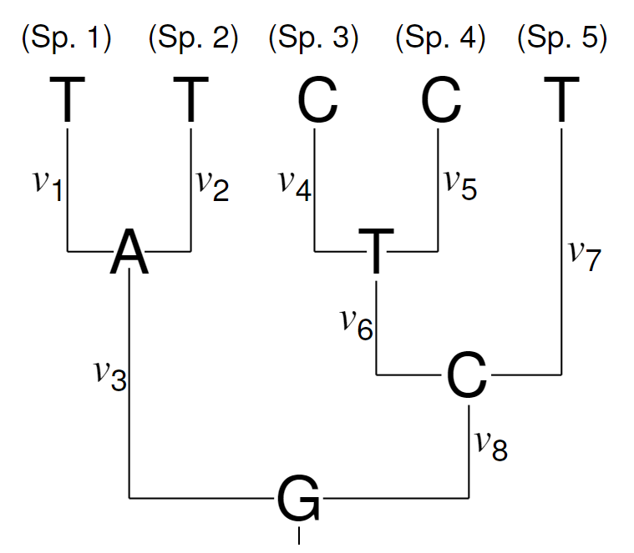
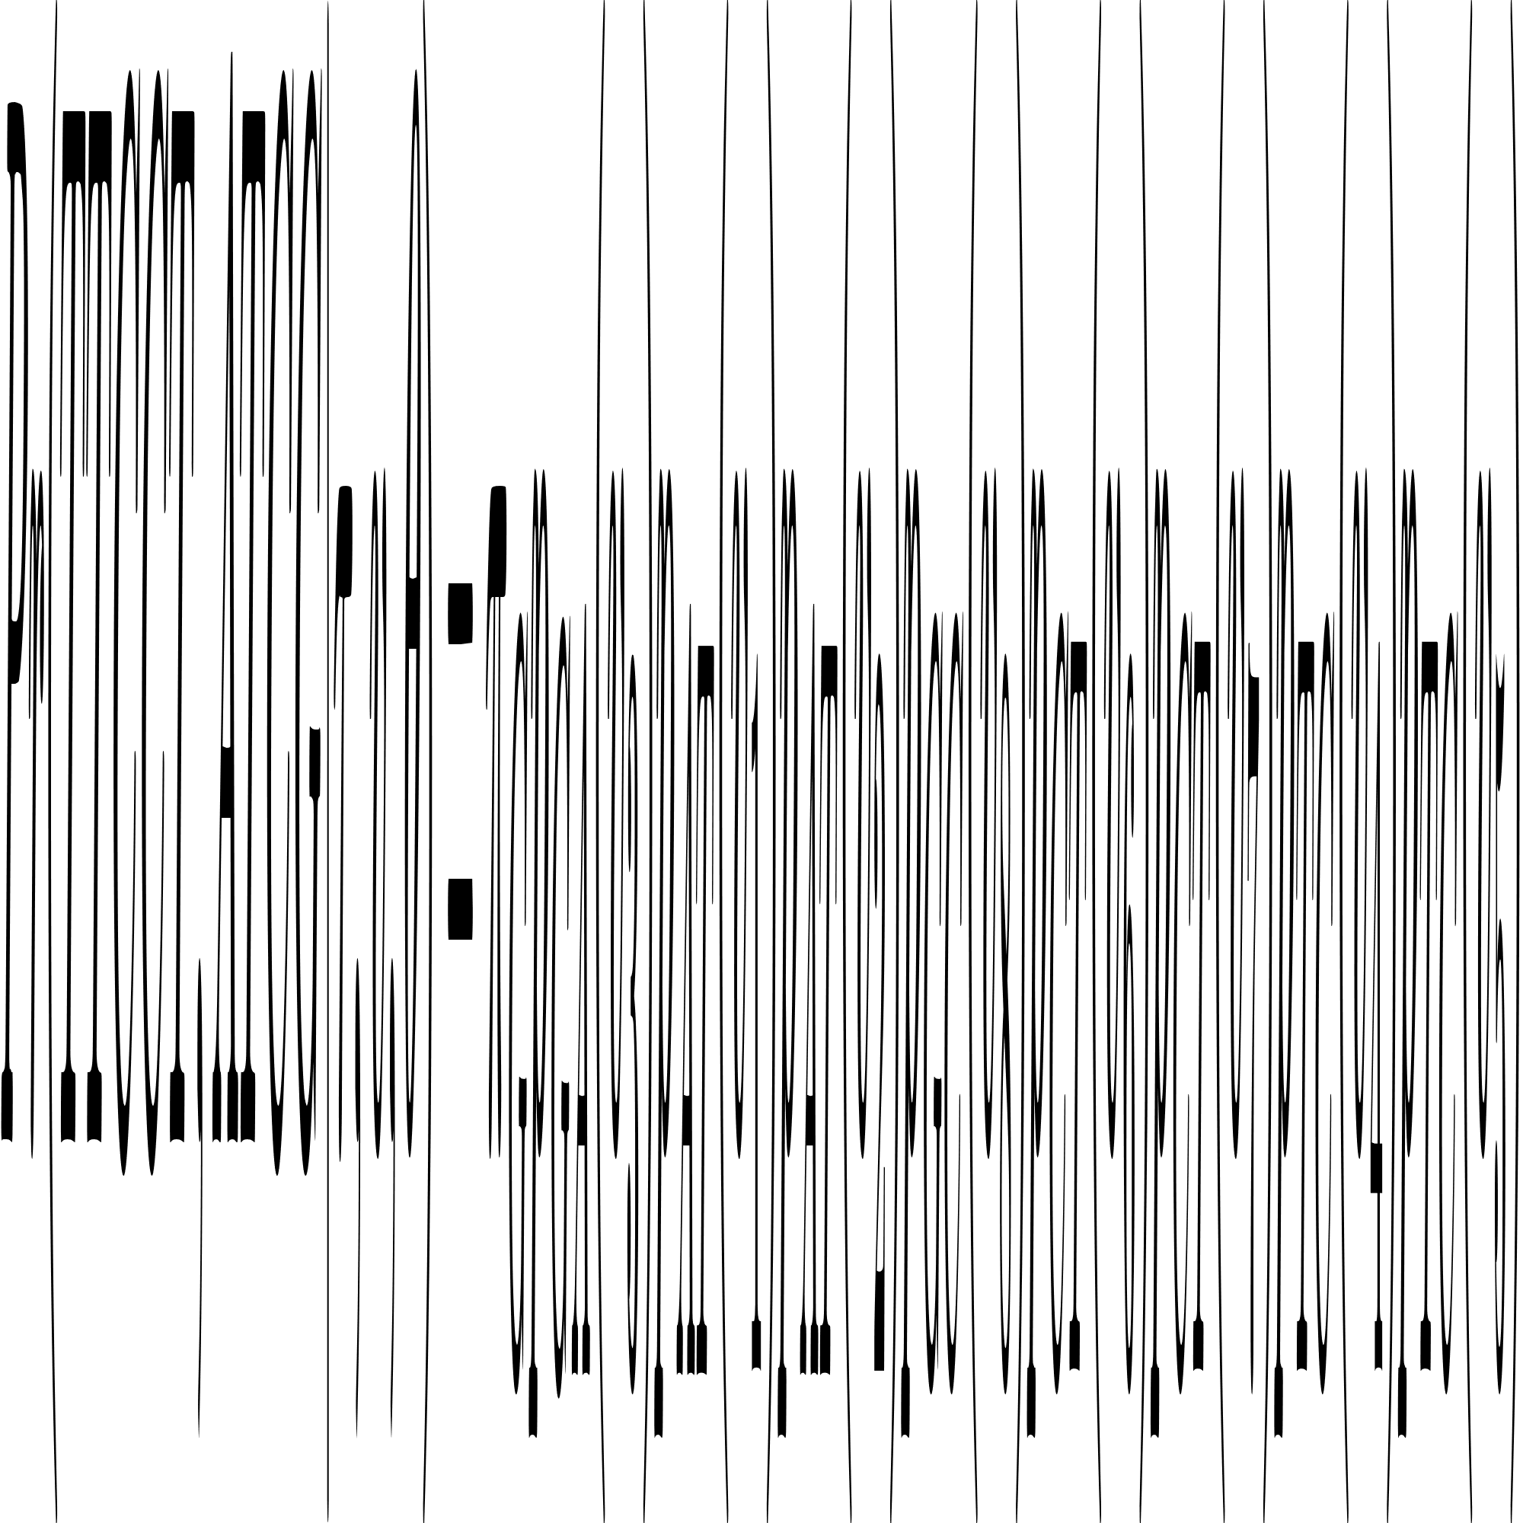
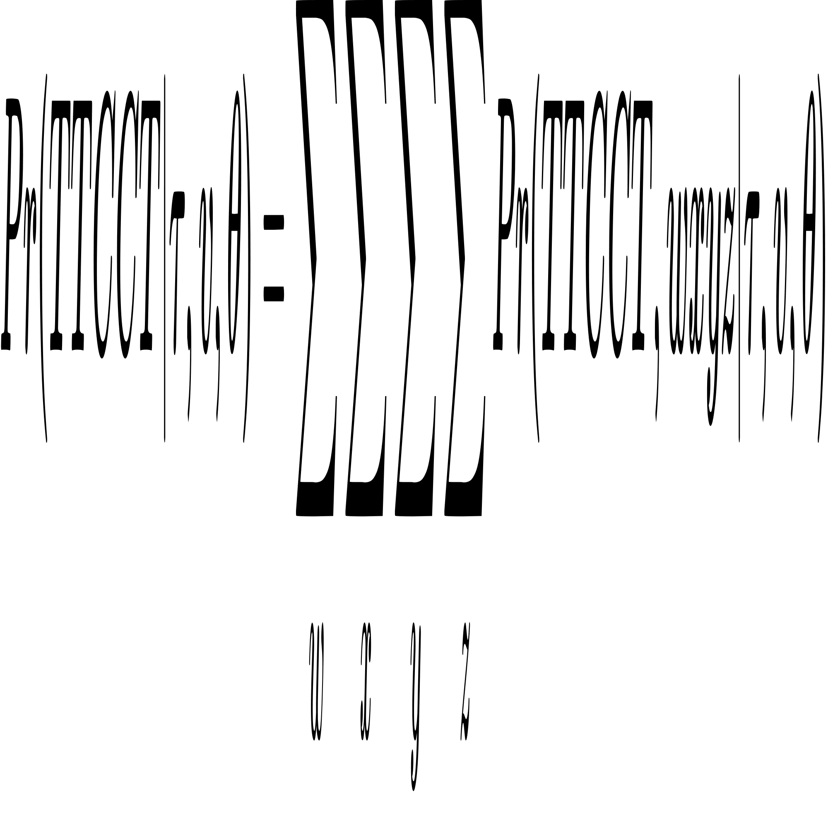
Column Probablity

Slide 16
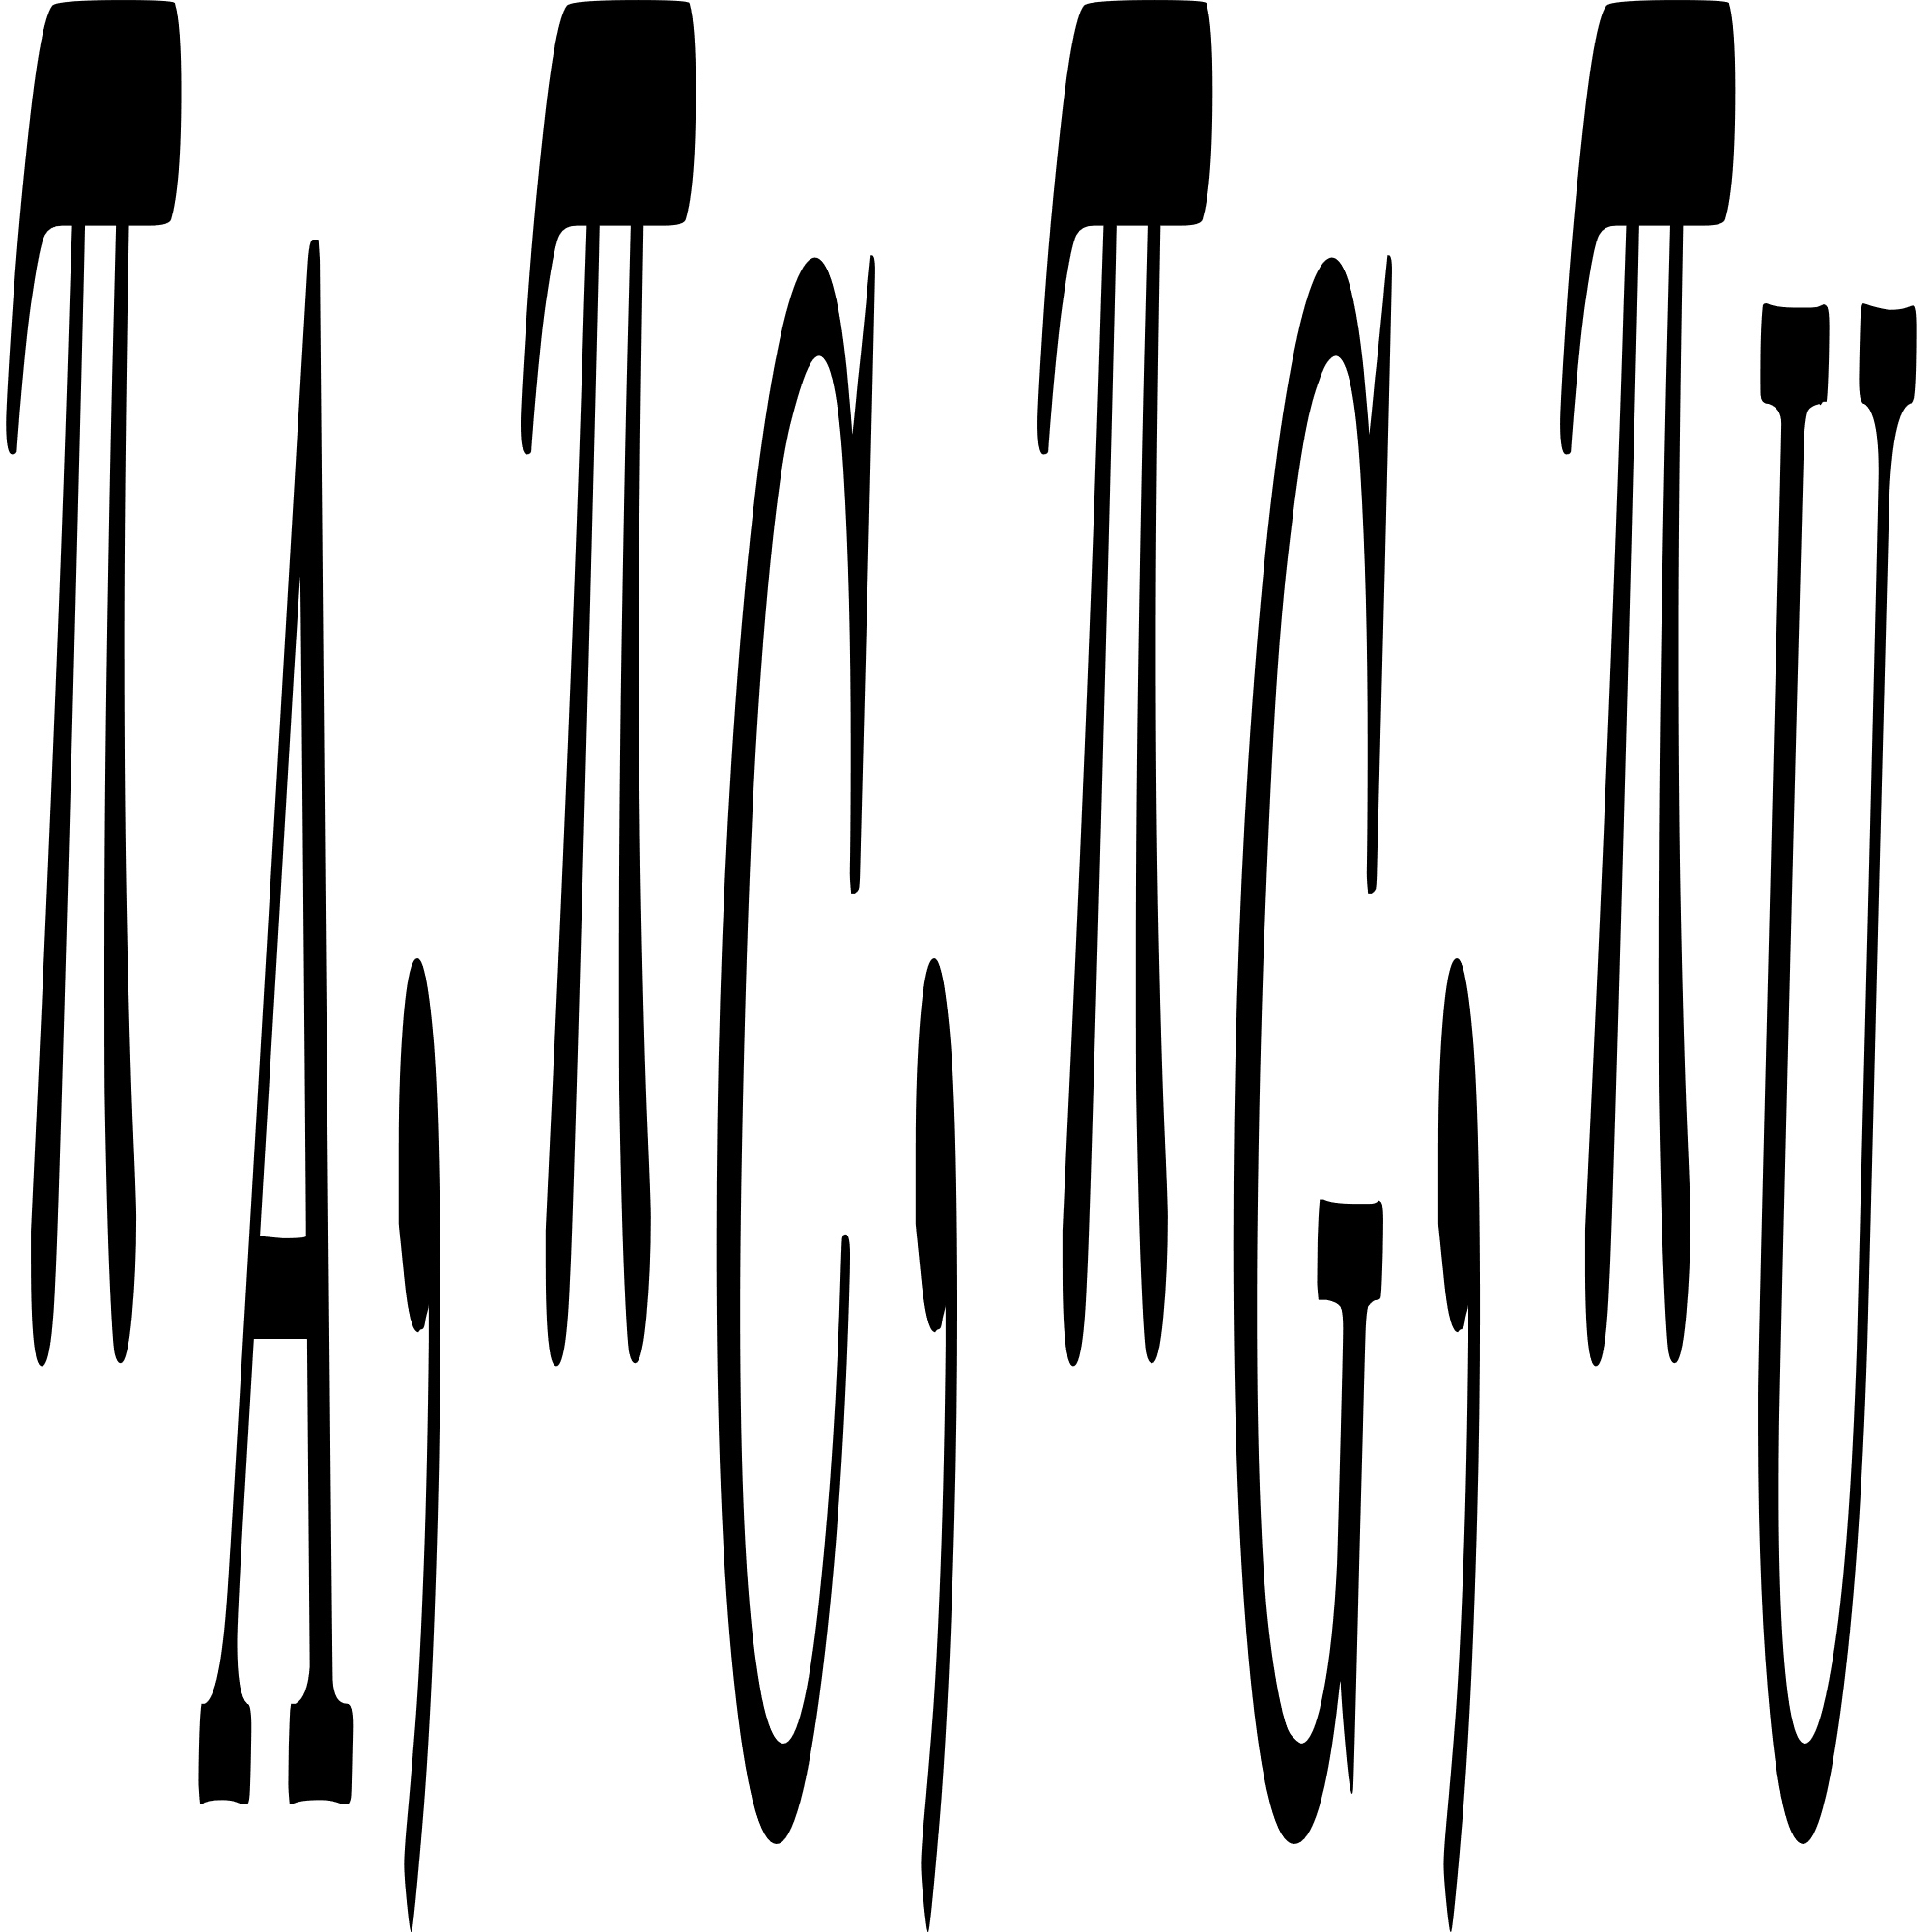
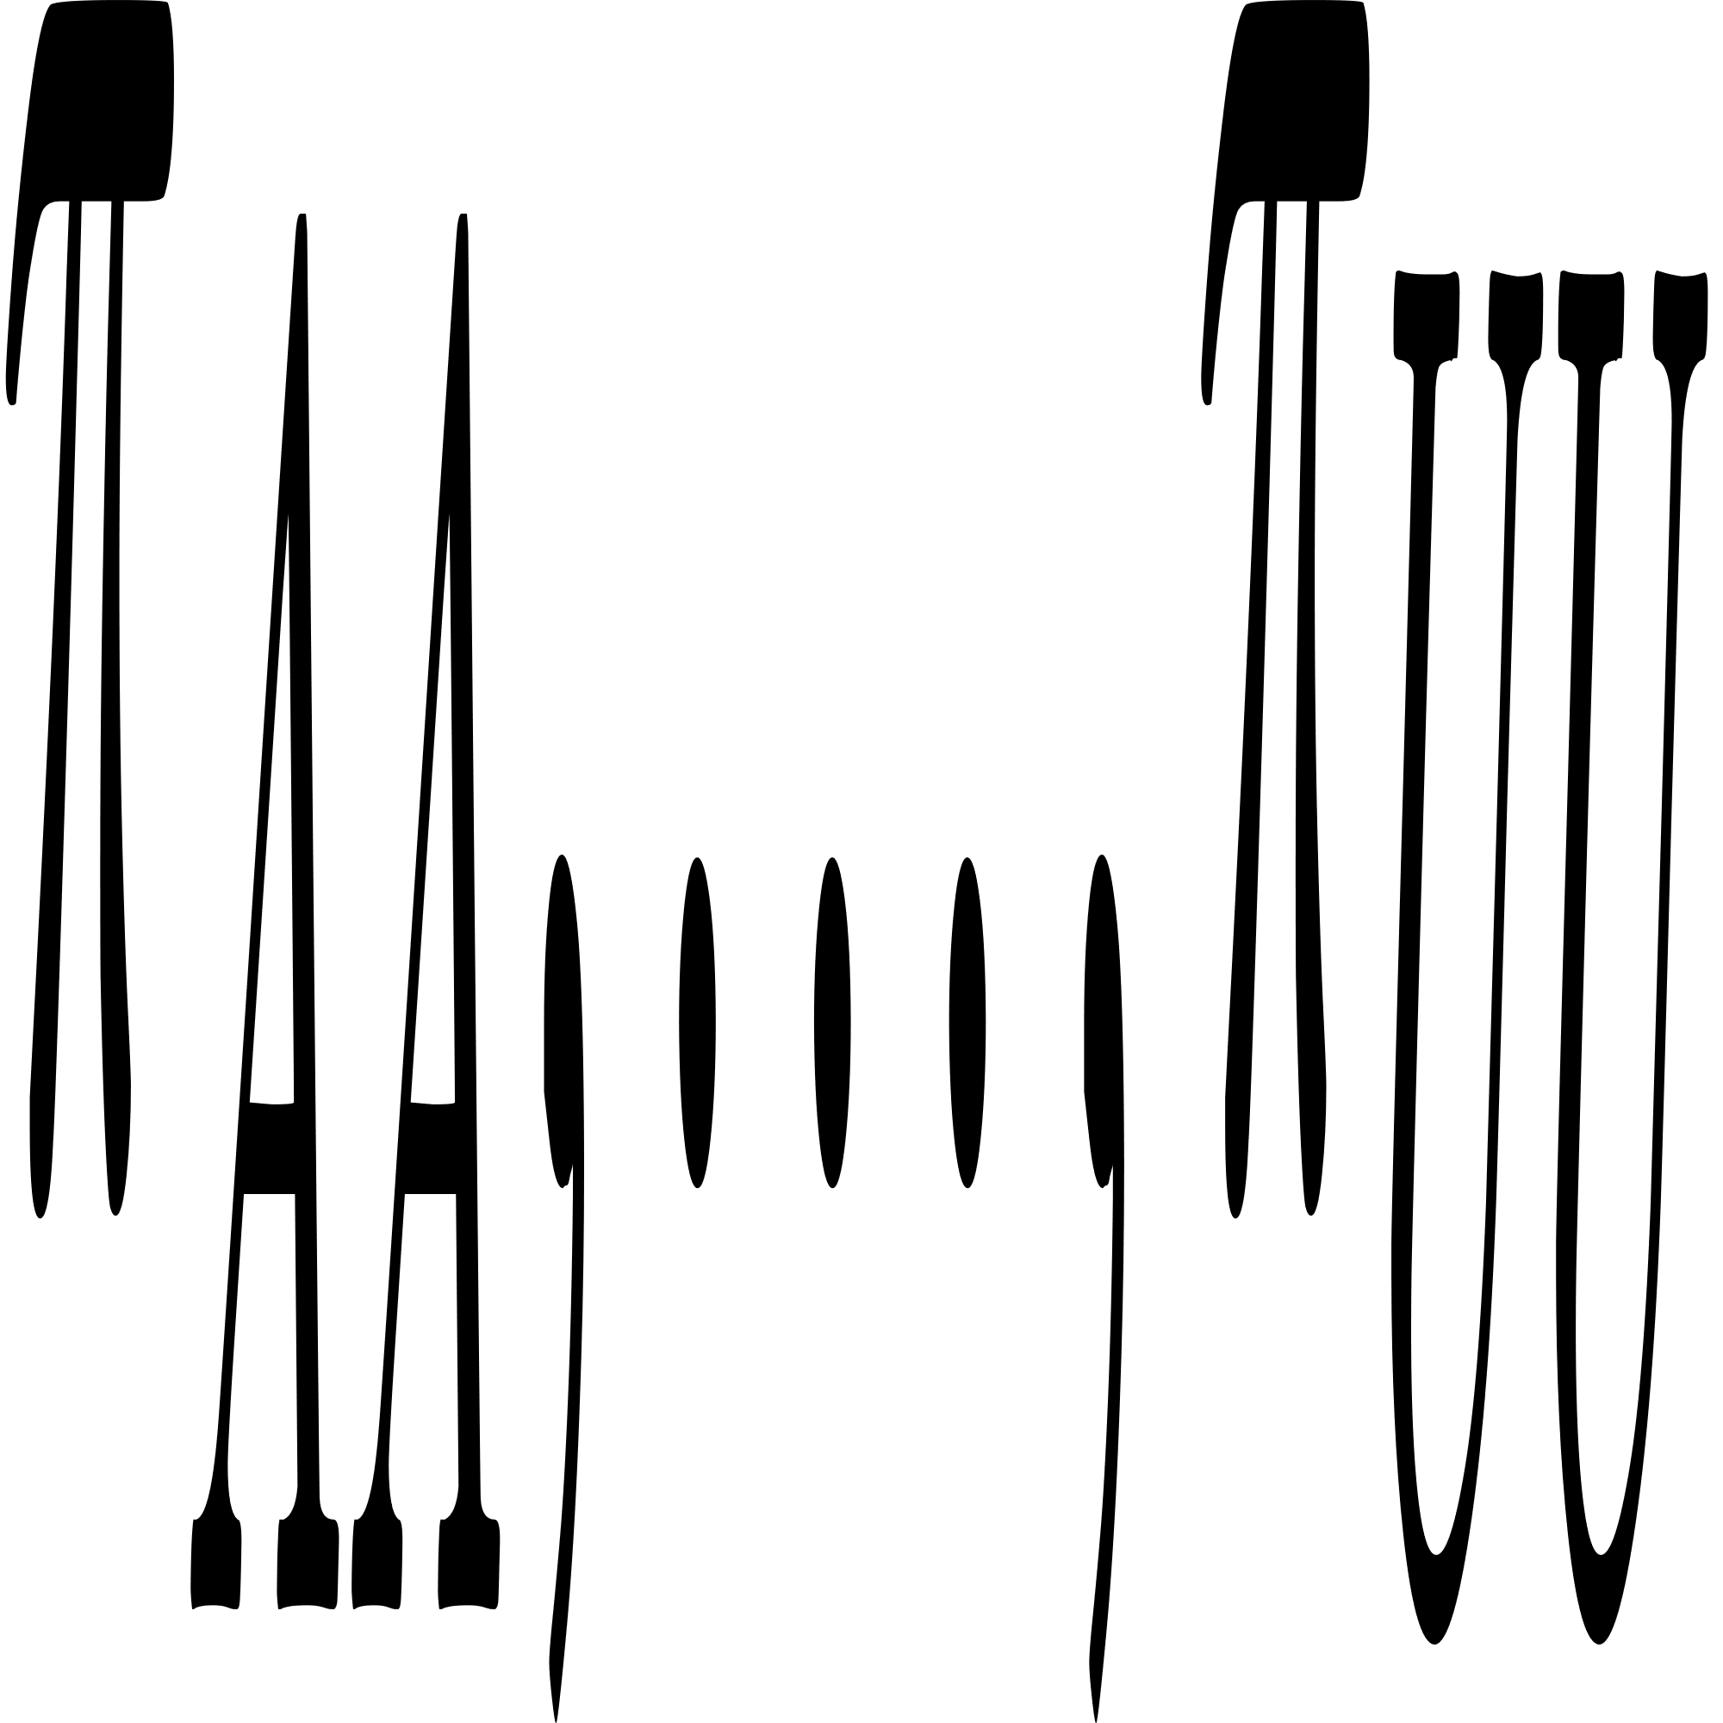
Calculating Frequencies (π)
Non-pairing Bases:
Counting A, C, G and U, and finding each ratio to all non-pairing bases.
Pairing Bases:
Counting AA, AC, AG, AU and ... and finding each ratio to all base pairs.
Also we need ratio of pairing and non-pairing bases to all bases. (Using later)

Slide 17
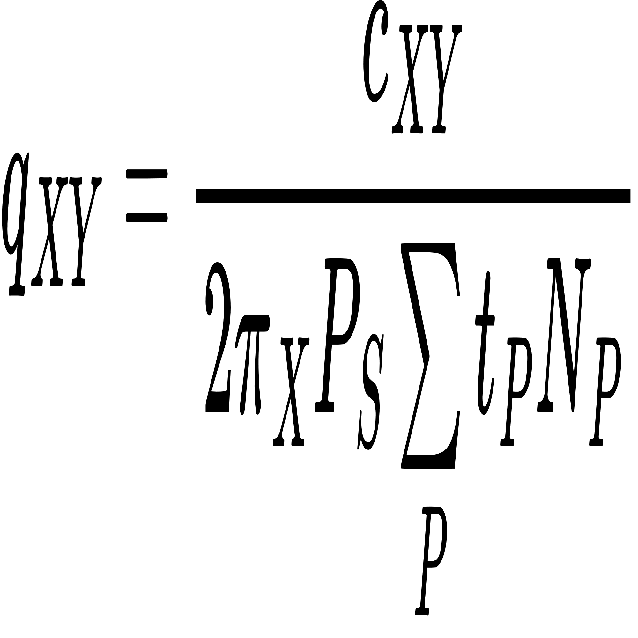
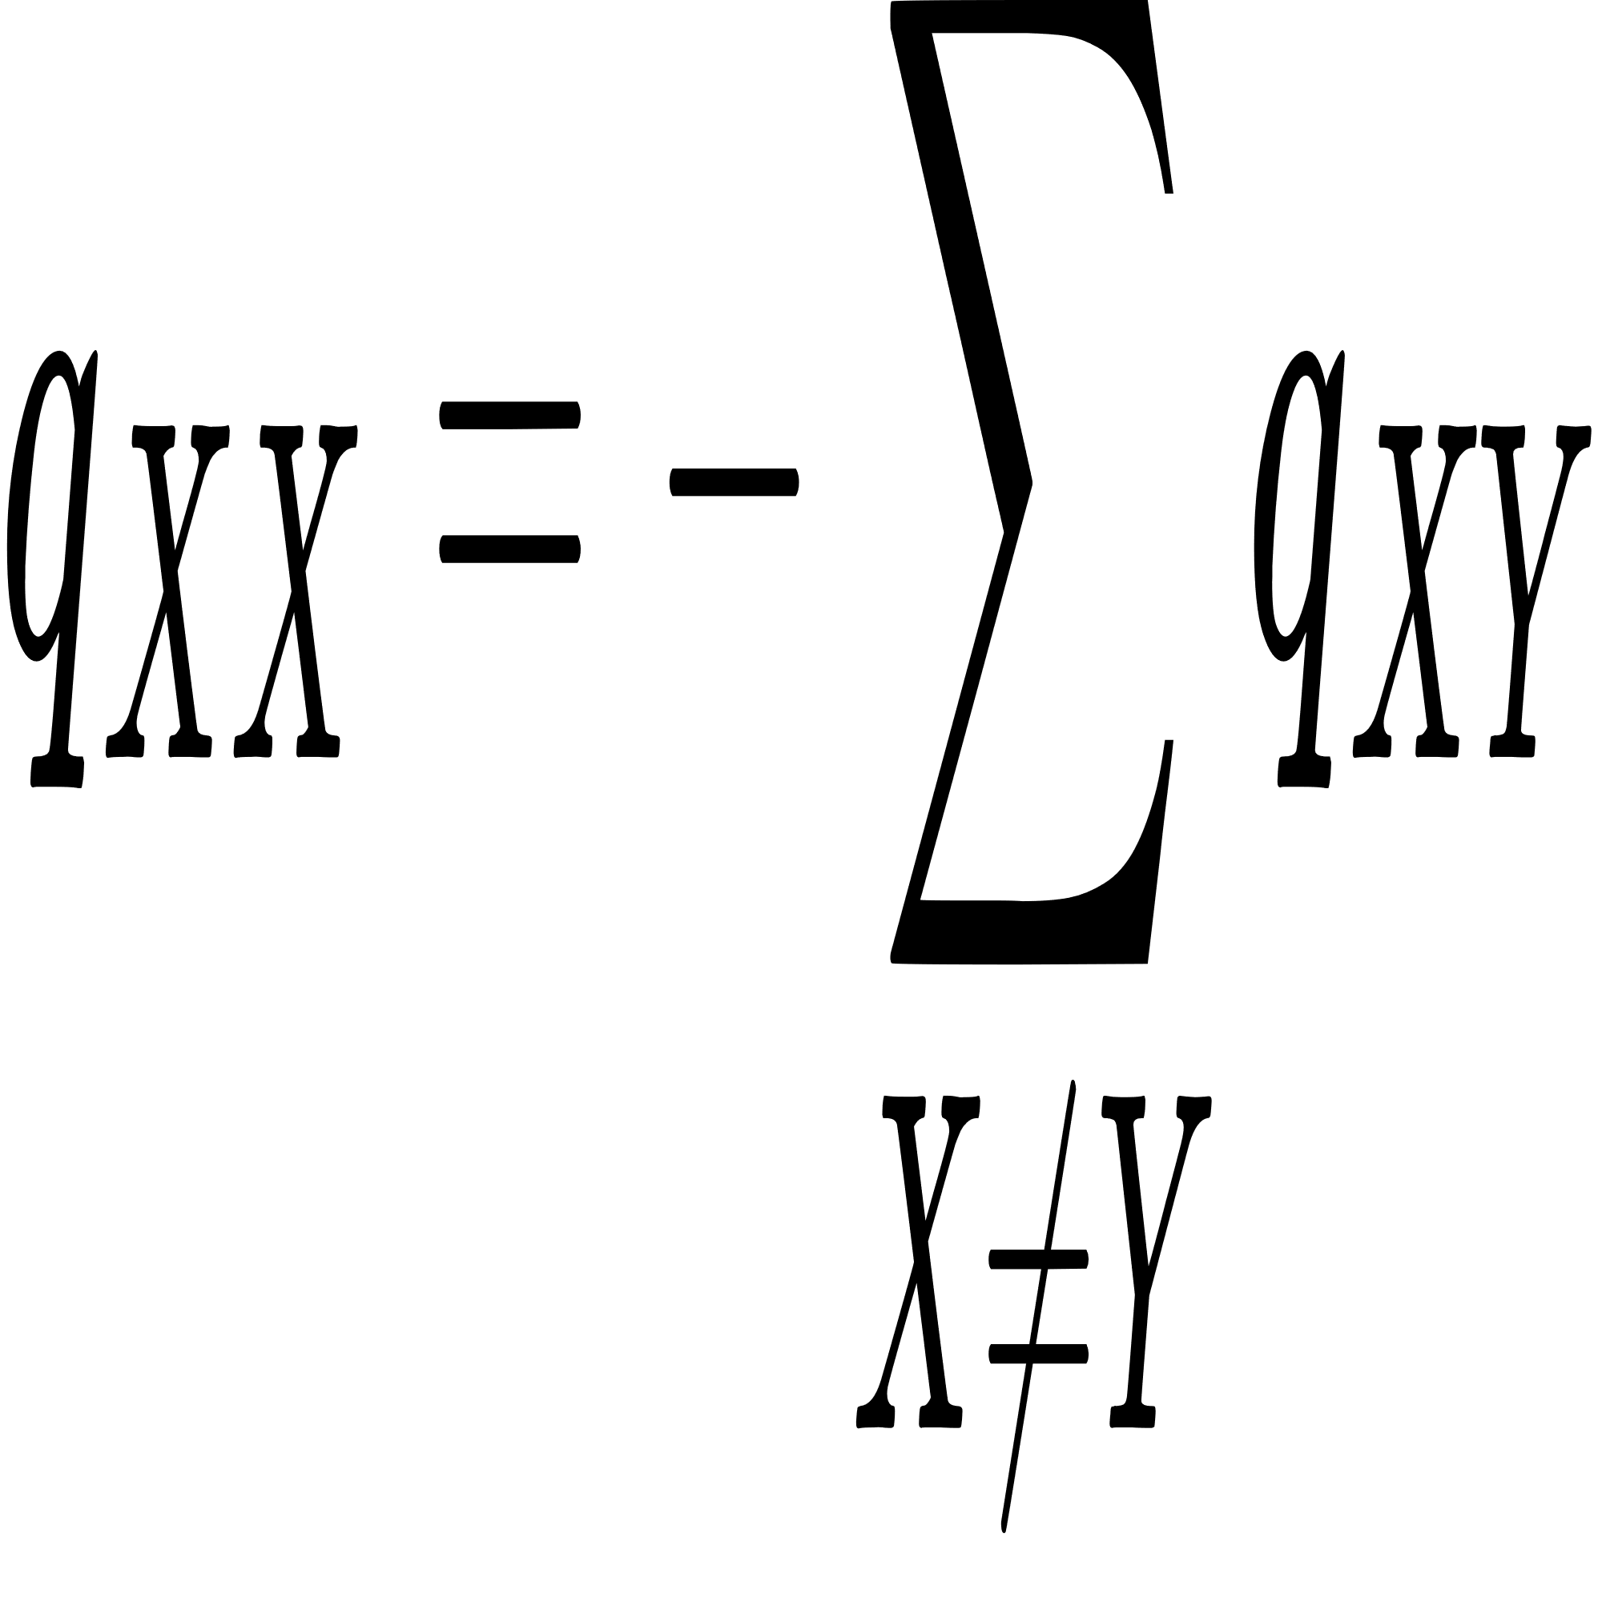
Calculating Mutation Probablity (p)
To calculate mutation probablity, first we calculate mutation rate matrix (Q). (spreadly for non-pairing and pairing bases)
In Q matrix for X ≠ Y:
After calculating values above:

Slide 18
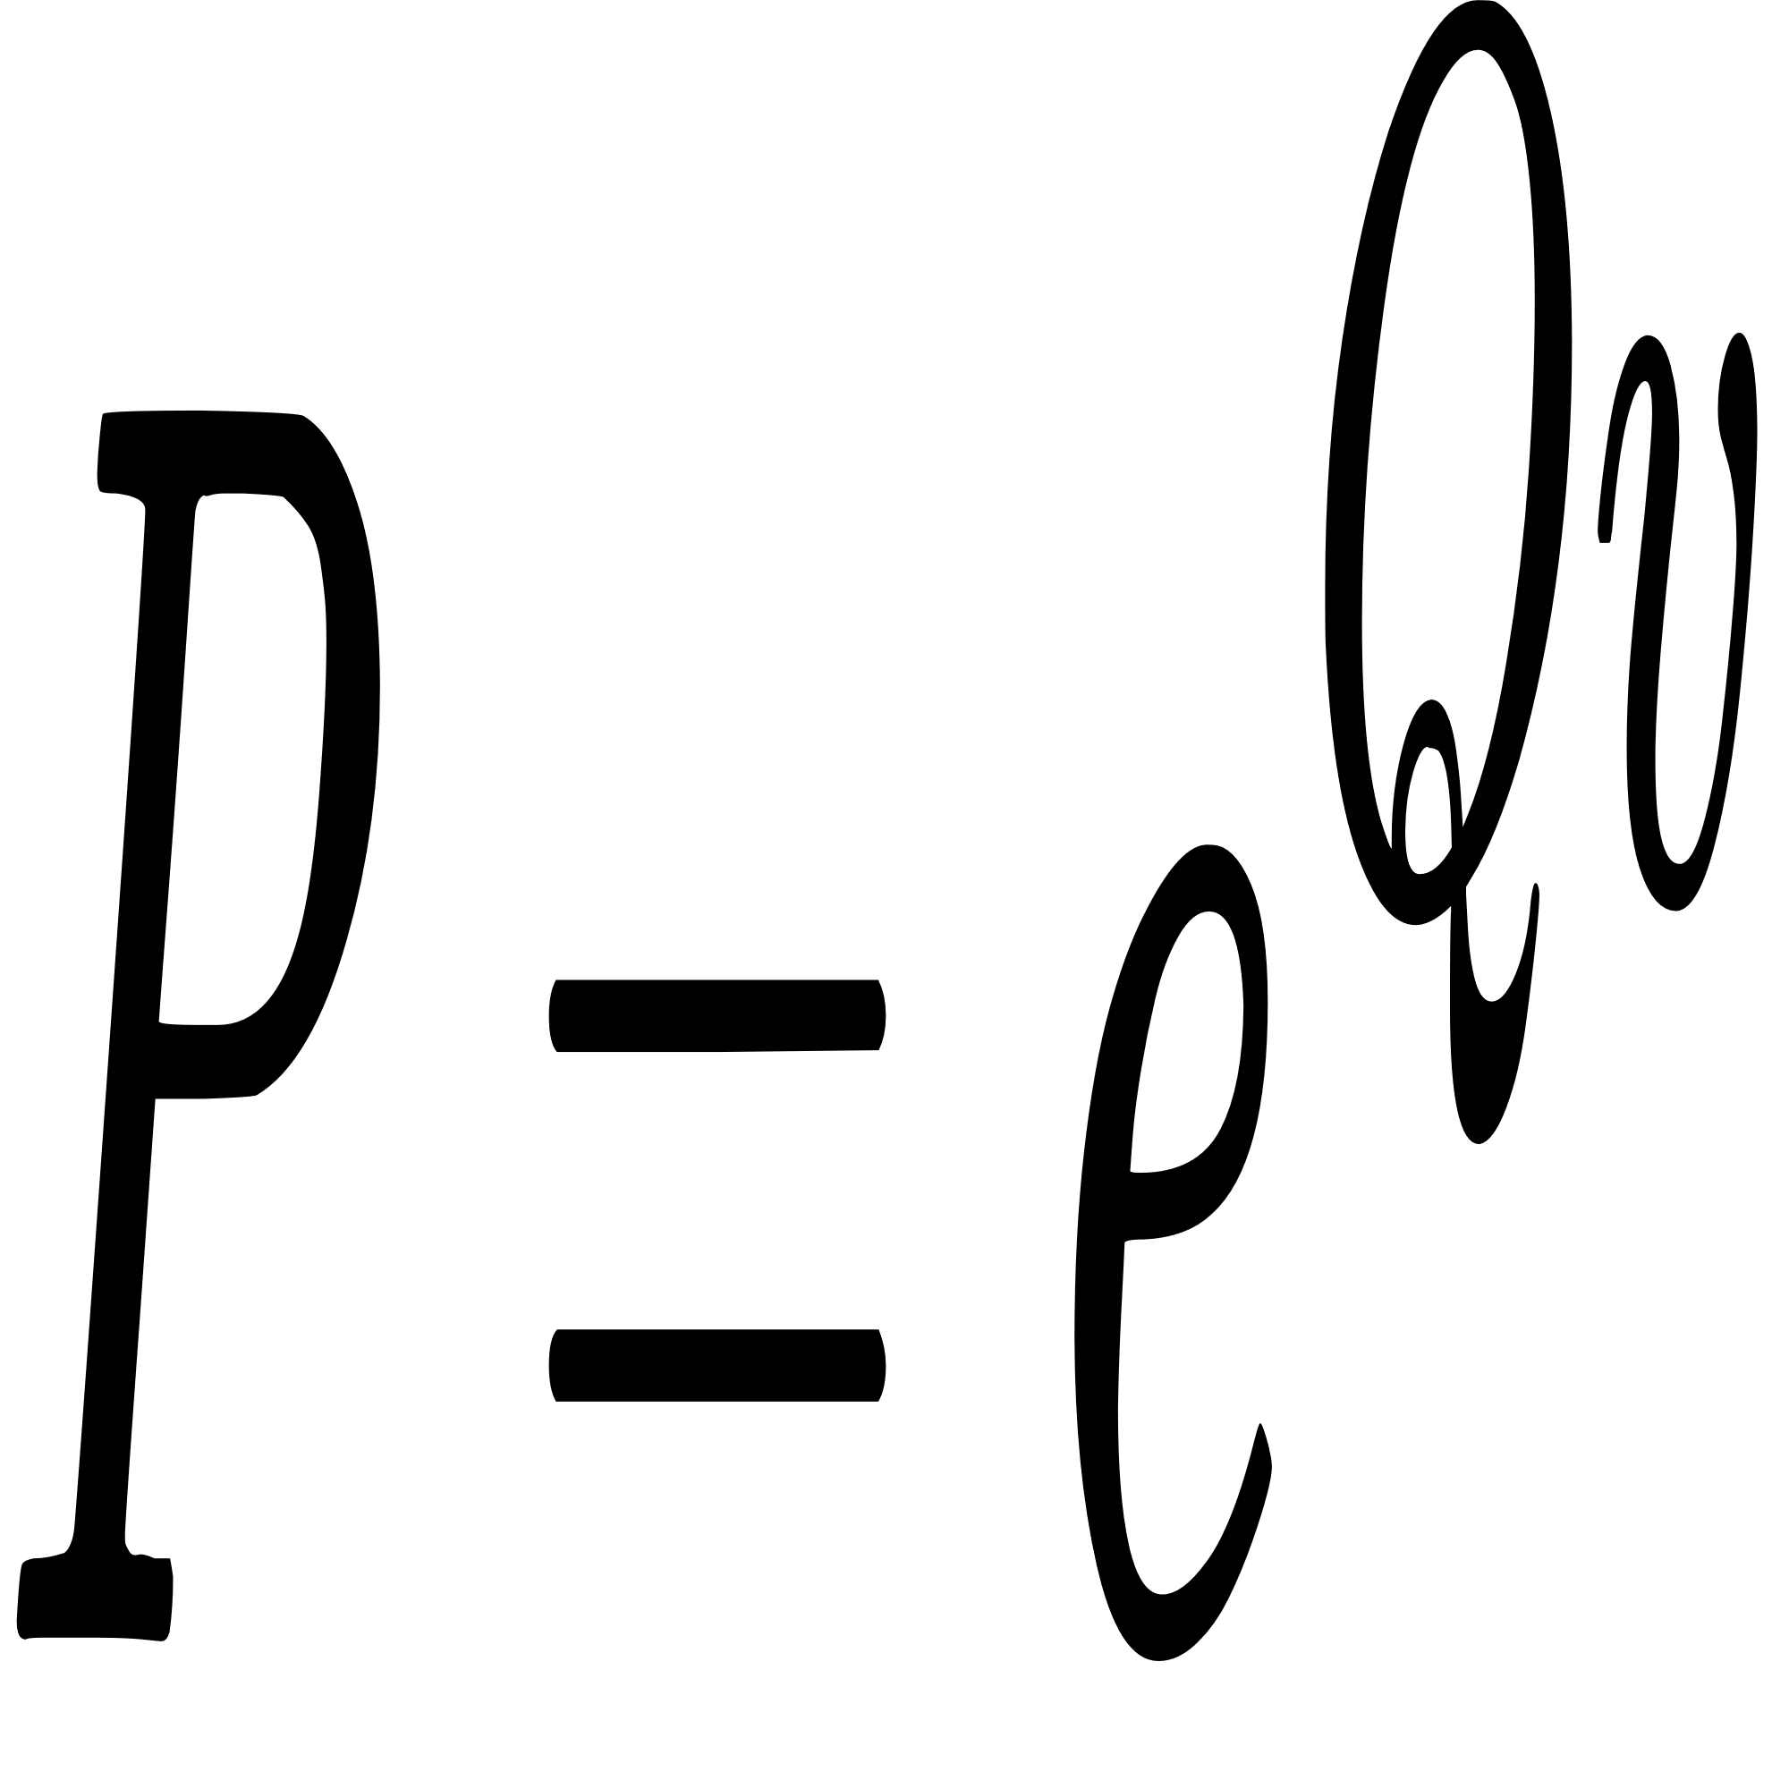
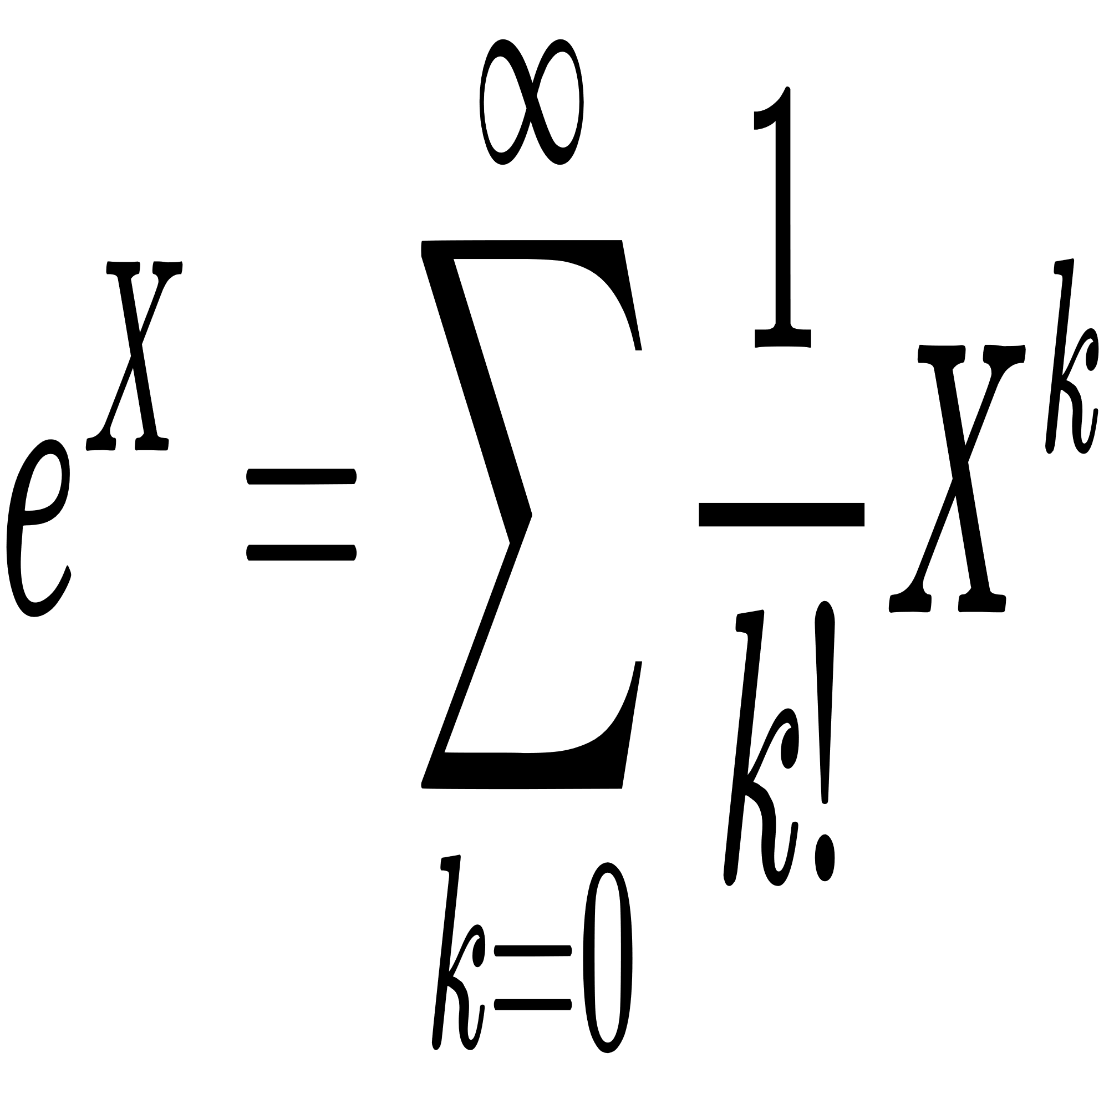
Calculating Mutation Probablity (p)
To calculate mutation probablity, from rate matrix (Q):
After calculation, we can take mutation probablity needed from P matrix
Exponential of matrix:

Slide 19
04
Grammar Algorithms

Slide 20
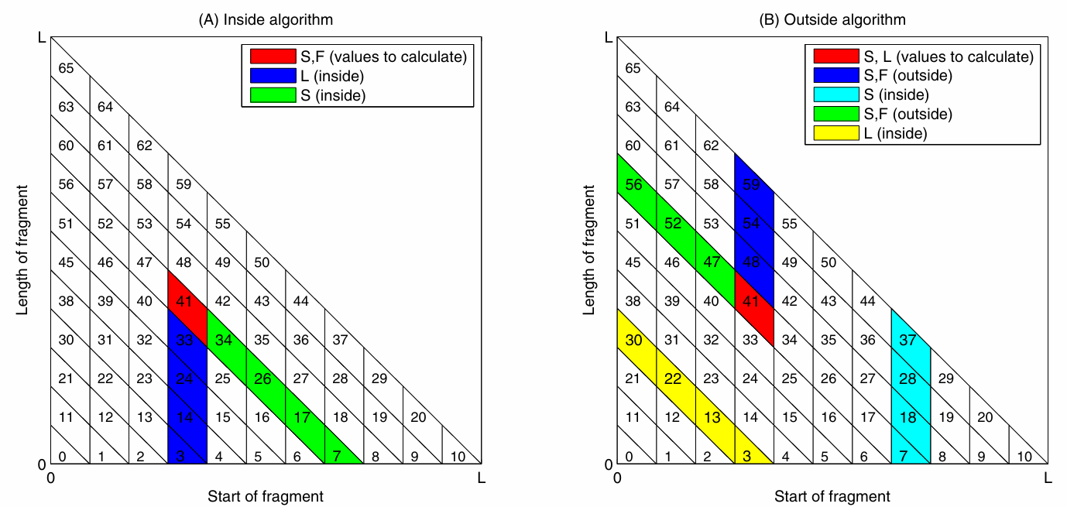
Inside Outside Algorithm

Slide 21
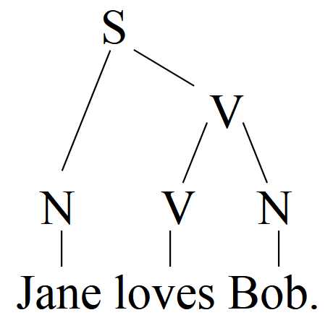
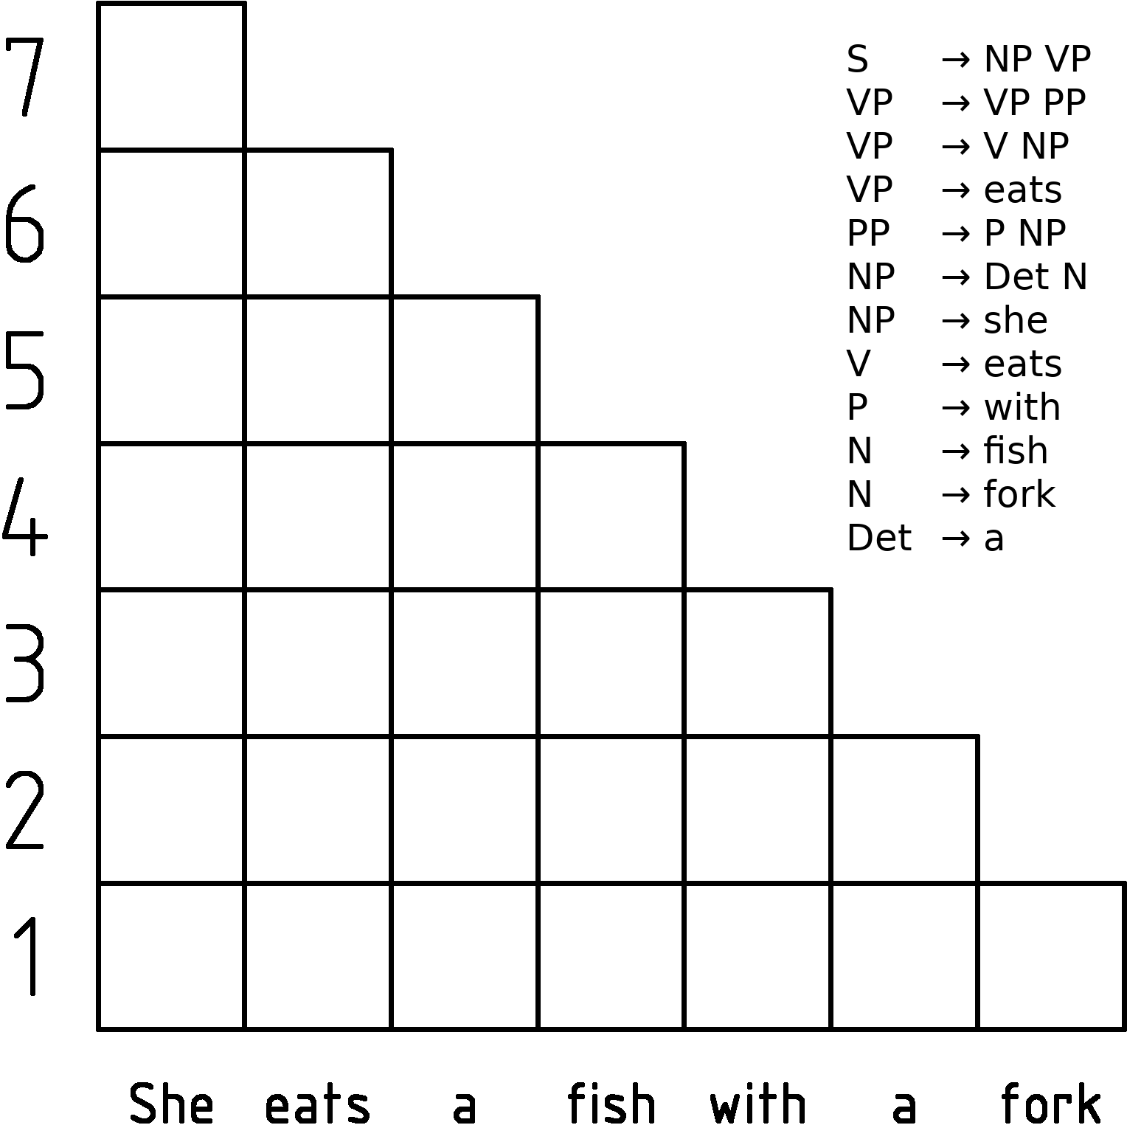
Cocke Younger Kasami algorithm

Slide 22
02
Implementation

Slide 23
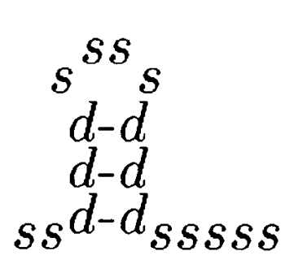
Inside Outside Algorithm
S -> L S
S -> Dm Dr
F -> Dm Dr
F -> L S
L -> Dm Dr
Dm -> Dl F
S -> s
L -> s
Dl -> d
Dr -> d
S -> L S 0.92
S -> Dm Dr 0.02
F -> Dm Dr 0.82
F -> L S 0.18
L -> Dm Dr 0.05
Dm -> Dl F 1.0
S -> s 0.06
L -> s 0.95
Dl -> d 1.0
Dr -> d 1.0
... ((((((................)))))) ...
(In Stockholm File)
+
=
Terminal ‘s’ stands for a single base, and ‘d’ stands for a pairing base.

Slide 24
Extending Grammmar
After calculating column probablities:
S -> L S 0.92
S -> Dm Dr 0.02
F -> Dm Dr 0.82
F -> L S 0.18
L -> Dm Dr 0.05
Dm -> Dl F 1.0
S -> s 0.06
L -> s 0.95
Dl -> d 1.0
Dr -> d 1.0
S -> L S 0.92
S -> ('A','A') 0.00847
S -> ('C','A') 0.00015
S -> ('G','A') 0.00017
S -> ('U','A') 0.00018
S -> ('A','C') 0.00014
S -> ('C','C') 0.00294
S -> ('G','C') 0.00005
...
+
Column Probablity
=
By running CYK on extended grammar we can get the secondary structure by checking witch rule ended t o terminal ( Dl -> ‘(’ , Dr -> ‘)’ , others -> ‘.’ )

Slide 25
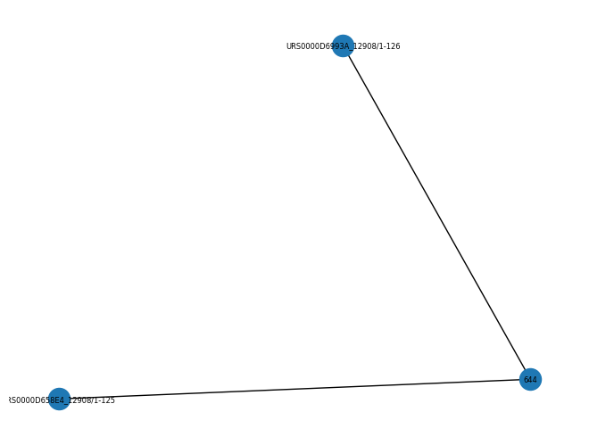
Example
Input:
"URS0000D658E4_12908/1-125"
"URS0000D6993A_12908/1-126"
Output:
(((((((((.(((((((...........................))))))))))))))))............(((((((((((((((((((((((((.........................))))))))))))))))))))))))).((((((.(((.......))))))))).((((((................))))))

Slide 26
Thanks For Attention

